Slide 1
Customer Churn Prediction for PowerCo Using Machine Learning
Summary of key findings from churn model development
90.3% model accuracy using Random Forest classifier

Slide 2
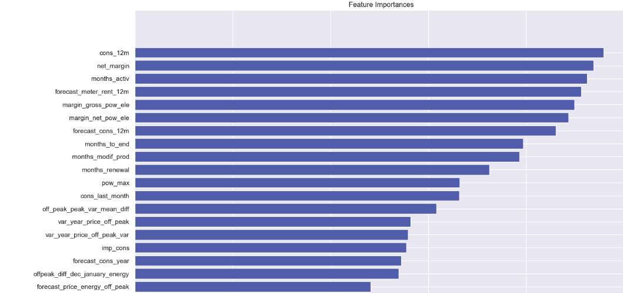
Executive Summary
Situation
PowerCo is experiencing customer churn and aims to proactively identify clients at risk of leaving, using historical service and behavioral data.
Complication
Despite high overall satisfaction, a small but critical segment of clients has been churning, often without early indicators. Conventional metrics fail to provide actionable foresight on these patterns.
Question
Can we build a model to predict churn risk and highlight the most influential drivers behind client attrition?
Answer
We engineered over 50 features from customer activity, pricing behavior, and contract metadata, and trained a Random Forest model achieving 90% accuracy. While churn events are rare, the model effectively identifies key predictors such as `cons_12m`, `net_margin`, and `months_activ`. These insights can guide targeted retention strategies for high-value clients at risk.

